Slide 1
Data Science Workshop
Day 3
Samarth Gupta

Slide 2
Today’s Plan
Why ML
ANN
  Artificial Neuron
  Activation function
  Single Layer Perceptron
  Multi-Layer Perceptron
  Back-Propagation Algorithm
Project: Logic Gates

Slide 3
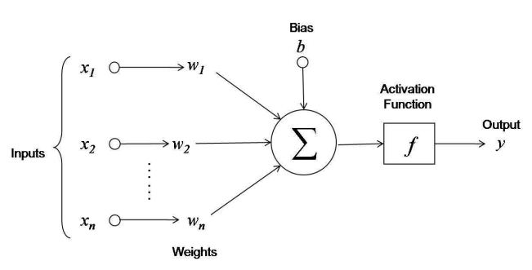
Artificial Neuron
The weighted sum of the input signal is calculated
v = w1*x1 + w2*x2 + … +wn*xn + b
The output from the activation function to the weighted sum is passed outside.
Y = f(v)
Notes:
• The circle and arrow of the figure denote the node and signal flow, respectively.
• 𝑥1 , 𝑥2 , 𝑎𝑛𝑑 𝑥3 are the input signals.
• 𝑤1 , 𝑤2 , 𝑎𝑛𝑑 𝑤3 are the weights for the corresponding signals.
• Lastly, b is the bias, which is another factor associated with the storage of information.
• In other words, the information of the neural net is stored in the form of weights and bias.
Training Method or Learning
Supervised Learning: input, correct output
Unsupervised Learning:
Reinforcement Learning: input, some output, grade for this output

Slide 4
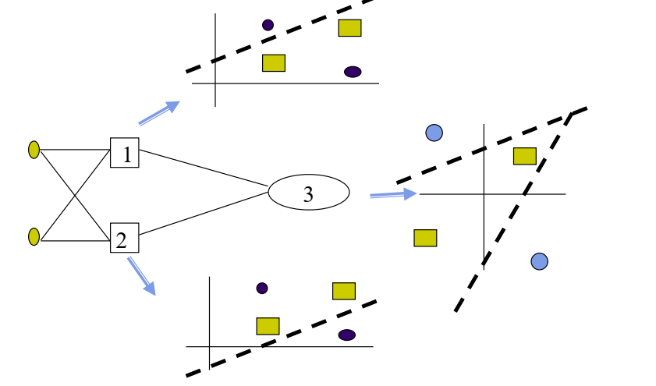
Solution of the XOR Problem
Piecewise linear classification using a Multi-layer perceptron

Slide 5
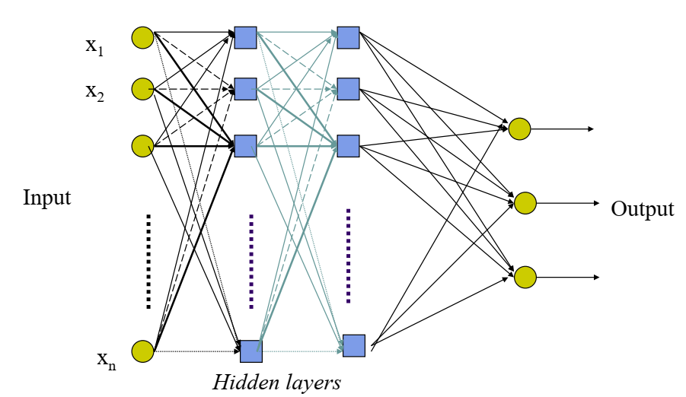
Multi Layer Perceptron
No direct connections between input and output layers
Fully connected between layers
Each unit is a perceptron
No connections within a layer

Slide 6
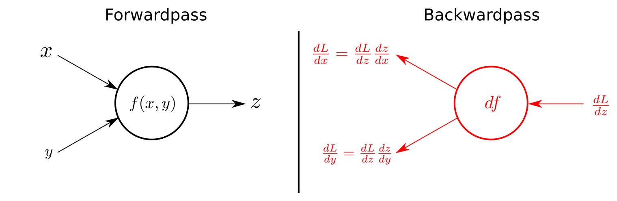
Back-propagation Algorithm
Forward Pass phase:
  Initialize the weights and biases randomly
  Compute the predicted output
  Compute the loss
Backward Pass phase:
  Compute error
  Update weights
  Repeat till convergence
Notes:
Forward pass phase: computes ‘functional signal’, feed forward propagation of input pattern signals through network
Backward pass phase: computes ‘error signal’, propagates the error backwards through network starting at output units (where the error is the difference between actual and desired output values)

Slide 7
Forward Pass
Initialize the weights and biases randomly
Compute the predicted output
  Compute Σwx + b
  Output (y) using Sigmoid as Activation
  This completes a single forward pass, where our predicted_output needs to be compared with the expected_output.
  Compute the loss
Notes:
The same way we did for AND gate

Slide 8
Backward Pass
Compute the loss
Weights for layers are changed using back propagation.
Back propagation is done using the Gradient Descent algorithm.
Notes:
The same way we did for AND gate

Slide 9
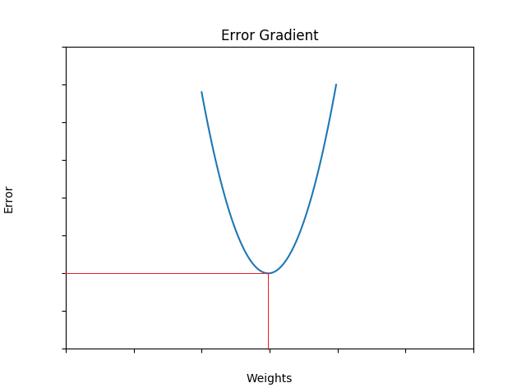

Gradient Descent
Loss function of the sigmoid neuron = squared error loss between desired value (t) and obtained value (y)
Goal:
  find weights such that error is minimum
  i.e. minima of the error gradient
Plot of the loss/error against the weights

Slide 10
Learning Rate (alpha: α)
Controls how big a step we take down the gradient decent curve

Slide 11
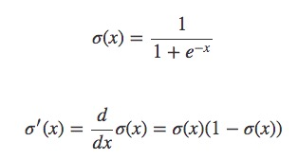
Derivative of Sigmoid
Take derivative of the activation function in the backward pass

Slide 12
Problem Statement
Create a Boolean Solver with the following Boolean Logic Gates
  OR
  NOT
  NAND
  NOR
  XOR
  XNOR

